Slide 1



GIES COLLEGE OF BUSINESS
GIES MARCOM WEB ANALYTICS
BUSINESS PRACTICUM
May 02, 2025

Slide 2

GIES COLLEGE OF BUSINESS
Introduction
Fall 2024 Recap
Requirements & Data
Goals & KPIs
Analysis
Proposals & Takeaway
Learnings
Agenda

Slide 3



GIES COLLEGE OF BUSINESS
Introduction
Gies Marcom is analysing user behaviour, improving data tracking, and integrating data insights to optimize the Gies College of Business websites for better user experience and conversions.
Website Role: Giesbusiness and Giesonline are key platforms for attracting and engaging students.
User Behavior Analysis: Studying how visitors navigate the sites to improve user experience.
Data Tracking Enhancement: Optimizing Google Analytics to collect accurate, actionable insights.
Marketing Impact Evaluation: Linking marketing spend data to user engagement and conversion performance.

Slide 4


GIES COLLEGE OF BUSINESS
Fall 2024 Recap
Focused on understanding business objectives, identifying KPIs, and evaluating the existing analytics setup.
Defined key requirements including various types of website tracking and domain differentiation.
Analyzed reports and trends, highlighting increases in new and active users and key performance indicators like traffic sources and conversion rates.

Slide 5



GIES COLLEGE OF BUSINESS
Requirements & Data
Requirements
Data
Business Goals
Existing Analytics Setup
Collection of Solution Design Reference (SDR) Documents
Google Analytics Infrastructure Knowledge
Web Tracking Setup and Process
Data from Jan 15, to Apr 15 2025
Page Tracking Elements
Events
Users, Sessions, Views
Customer Journey Stats
Technology – Device Type, Browser, Operating Systems

Slide 6

GIES COLLEGE OF BUSINESS
Goals
Web Traffic Analysis
Optimize Web Experience
Enhance Tracking Elements
Increase Data Usage and Effectiveness
Understand Device Usage by Customers
KPI’s
Conversion Metrics
Sessions Per User
Number of New vs Returning Users
Top visited Pages and Sections
Demographic User Stats
Goals & KPIs

Slide 7



GIES COLLEGE OF BUSINESS
Data Analysis Process
Phase 1
Phase 2
Phase 3
Clarified business goals, framed key analytical questions, and aligned with stakeholders on KPIs, scope, and expectations to ensure strategic focus.
Integrated and cleaned multi-source data, applied exploratory and statistical techniques to perform Ad-hoc and trend Analysis, and uncovered actionable insights to guide decision-making.
Delivered compelling data stories through dashboards, presented strategic recommendations, and supported data-driven decisions that delivered measurable outcomes.

Slide 8
GIES COLLEGE OF BUSINESS
Analysis & Insights
New Users: Gies Business sees 90% new users (~336K), while Gies Online has 97% (~442K), driven by strong campaign efforts.
Engagement Time: Users spend 45s on Gies Business vs. 31s on Gies Online, indicating higher engagement on the business site.
Device Usage: Gies Business shows a balanced split (53% mobile, 44% desktop), whereas Gies Online is mobile-heavy (70% mobile, 26% desktop).
Traffic Source: Gies Business gets 50% of traffic organically, while Gies Online sees 53% from paid media (LinkedIn/Facebook).
Language Preference (Non-English): On Gies Business, 53% of non-English users prefer Chinese and 14% prefer Spanish.
Analysis performed in Google Analytics and Date Range - Jan 15, 2025, to Apr 15, 2025

Slide 9

GIES COLLEGE OF BUSINESS
Significant User Growth (YoY): Website traffic increased substantially from 2024 to 2025, with active users up 21.15% (to 393K) and new users up 26.50% (to 373K) in 2025.
Mobile Overtakes Desktop: Mobile became the primary access device in 2025 (51.8% of active users), surpassing desktop which was dominant in 2024 (53.18% of active users)
Distinct User Journeys by Device:
Desktop: Users primarily focus on application-related tasks (Status Portal, Instructions, References).
Mobile: Users mainly explore specific program offerings (Accountancy, Management, Business Analytics)
Gies Business Device Stats
Analysis performed in Google Analytics and Date Range - Jan 15, 2024 & 2025, to Apr 15, 2024 & 2025

Slide 10
GIES COLLEGE OF BUSINESS
Proposals & Takeaway
Enhance Page Funnel and Section Tracking.
Increased Data Retention period from current 2 months to 14 months.
Define URL tracking, UTM Parameters and Hierarchy tracking for better page identifications.
Improve Click tracking and expand as per business needs.
Differentiate Business vs Online Domains to better identify traffic.
Expand and further deep dive into customer behavior on business and online domains while using desktop vs. mobile devices.

Slide 11
GIES COLLEGE OF BUSINESS
Gained expertise in web analytics by understanding web tracking mechanisms and improving data collection.
Enhanced cross-cultural teamwork by collaborating effectively and sharing ideas with diverse teams.
Converted insights into strategies by developing actionable, data-driven measurement plans.
Adapted to dynamic environments by embracing innovation and integrating new ideas swiftly.
Refined technical skills in analyzing digital user behavior and optimizing web performance.
Improved communication by presenting complex data insights in clear, actionable formats for stakeholders.
Learnings

Slide 12

GIES COLLEGE OF BUSINESS
Thank You
Stakeholders – Priyanka Bhargava, Lindsey Savoie Halfar
Professor – Ashish Khandelwal
Students – Aditya Agarwal, Aarushi Nanda, Zixiao Liu, Yifei Wang, Lasya Venkata Lalpet

Slide 13
GIES COLLEGE OF BUSINESS
APPENDIX

Slide 14
GIES COLLEGE OF BUSINESS
 | Gies Business | Gies Online
New Users | 268K | 408K
Returning Users | 59K | 41K
Avg. Time Spent | 1m 10s | 32s
Home Page Views | 52K | 196K
Desktop vs Mobile | 65% vs 35% | 32% vs 68%
Fall 2024 Data
Date Range - Aug 22, 2024, to Nov 22, 2024

Slide 15

Fall 2024 Requirements
GIES COLLEGE OF BUSINESS
UNDERSTANDING BUSINESS
OBJECTIVES
GOALS AND KPI’S IDENTIFICATION
EXISTING SETUP EVALUATION
PERFORM PRELIMINARY SWOT ANALYSIS
GATHER REQUIRED DOCUMENTATION/ SDR
DIMENSIONS & METRICS ALIGNMENT

Slide 16
Dashboards
GIES COLLEGE OF BUSINESS
Gies Business
Gies Online

Slide 17
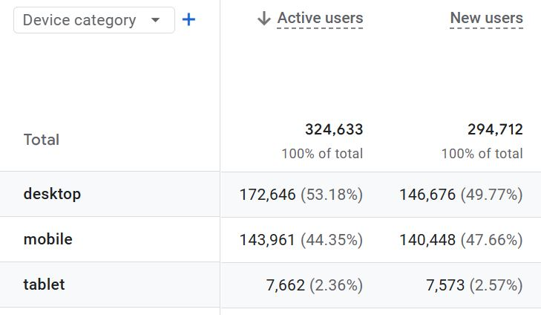
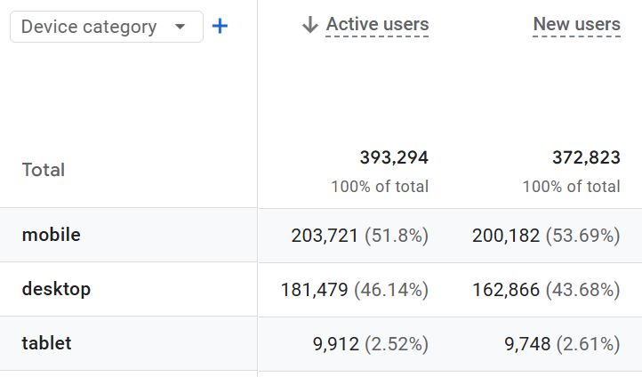
Device Stats
GIES COLLEGE OF BUSINESS
2024
2025

Slide 18
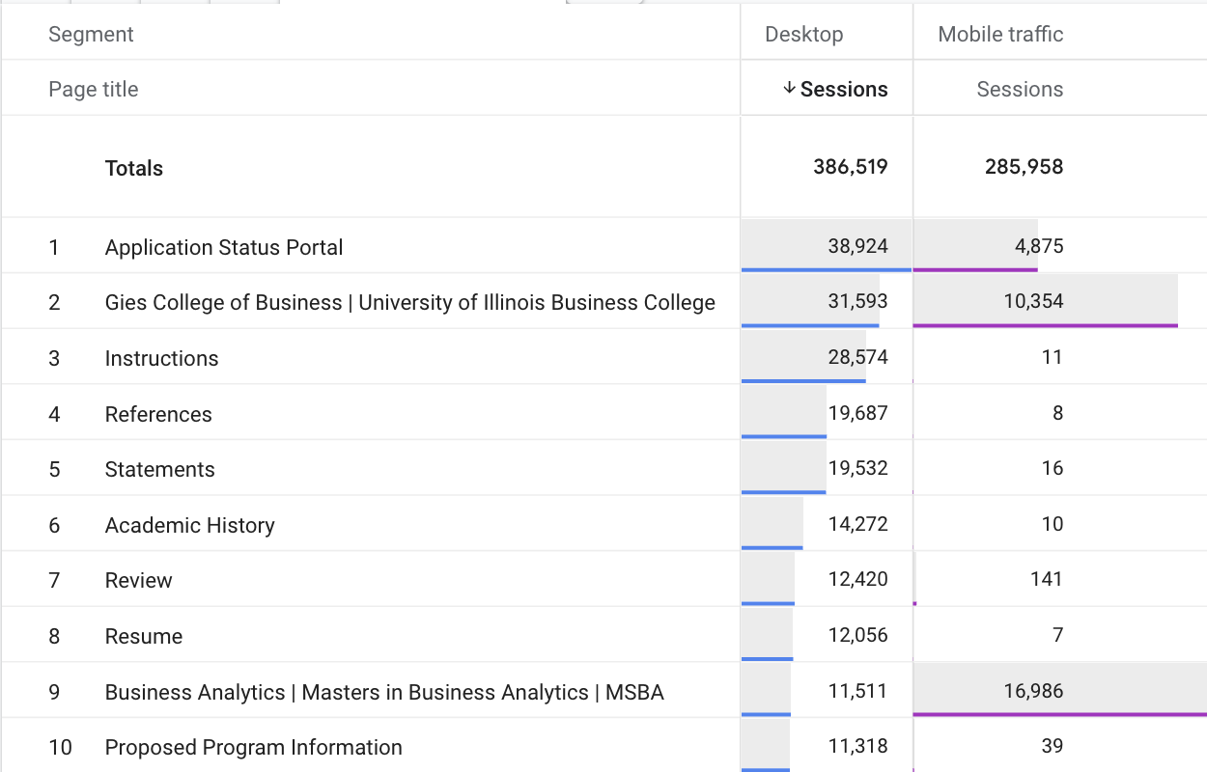
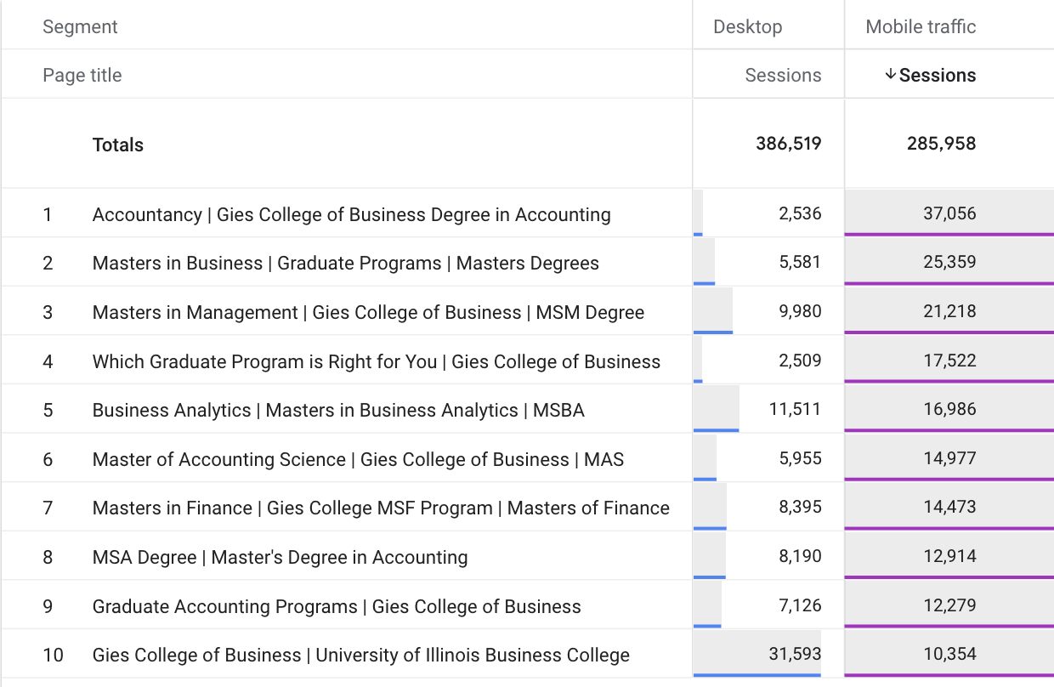
Device Stats by Pages - 2025
GIES COLLEGE OF BUSINESS
Top Pages by Desktop Device
Top Pages by Mobile Device

